Slide 1
Homework #12 Feedback
Pyomo implementation
Trends observed

Slide 2

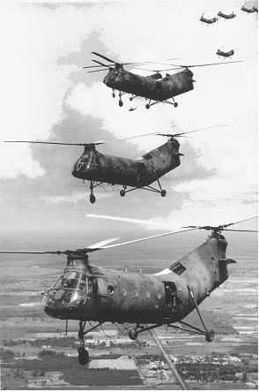
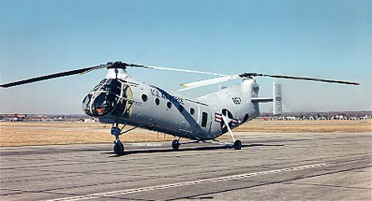
What is it?

Slide 3
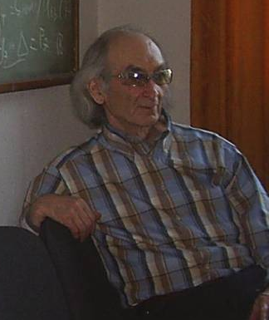
OPER 610 Lesson 17 Interior Point Method 2: The Affine Scaling Algorithm
1936 – 2008
Dr Brian J. Lunday
Office: Rm 201E, Bldg 641

Slide 4
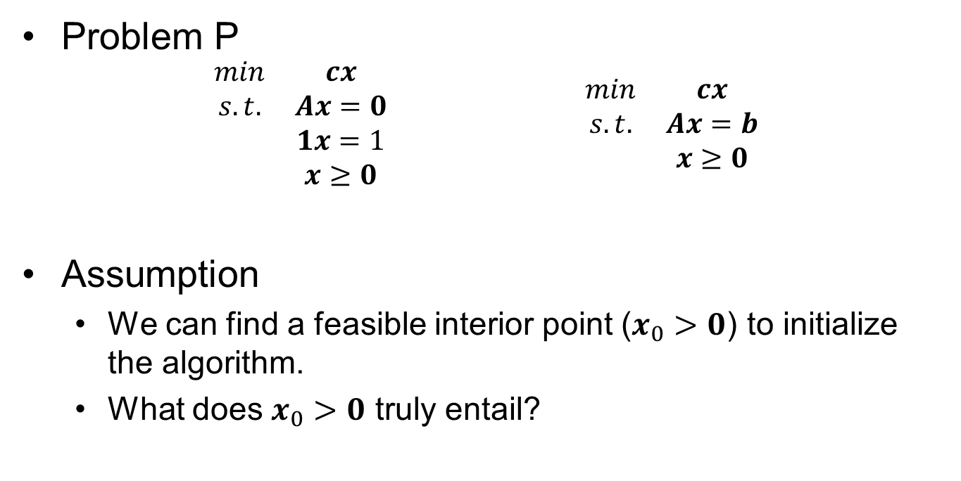
Basic Problem & Assumptions
Problem P
$$\begin{matrix}\begin{matrix}min & cx \\ s.t. & Ax=0 \\ & 1x=1 \\ & x≥0\end{matrix} & & & & \begin{matrix}min & cx \\ s.t. & Ax=b \\ & x≥0\end{matrix}\end{matrix}$$
Assumption
We can find a feasible interior point ($x_{0}>0$) to initialize the algorithm.
What does $x_{0}>0$ truly entail?

Slide 5
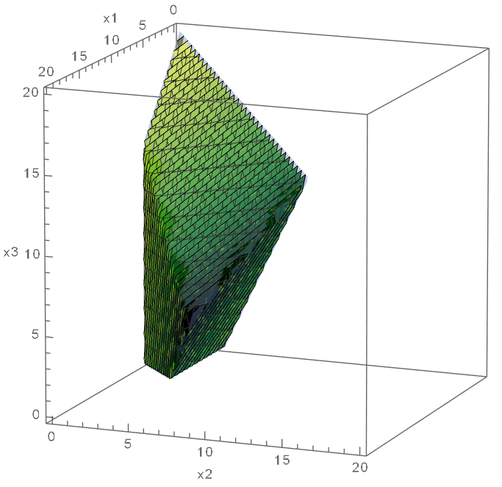

Geometry of the Simplex Method (2 of 2)
Slide from Lesson 4
$$\begin{matrix}min & −2x_{1}−5x_{2}+x_{3} \\ s.t. & x_{1}+x_{2}+x_{3}+x_{4} =20 \\ & 2x_{1}−2x_{2} +x_{5} =12 \\ & 4x_{2}−2x_{3} +x_{6}=12 \\ & x_{1},x_{2},x_{3},x_{4},x_{5},x_{6}≥0\end{matrix}$$
What does $x_{0}>0$ truly entail?
$$x1=0$$
$$x2=0$$
Key concepts to visualize
Optimal Solution
Extreme Points & Edges
Degenerate Extreme Point
BFS
Adjacent EPs/Entering NBVs
The Simplex. What/where is it?
Blocking hyperplane
Nondegenerate iteration/pivot
Simplex path
$$x4=0$$
$$x5=0$$
$$x6=0$$
$$x3=0$$

Slide 6
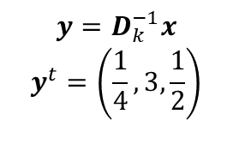

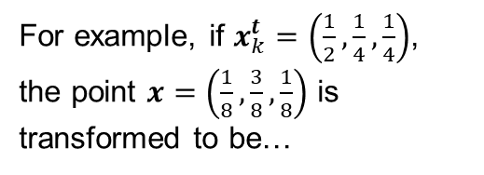
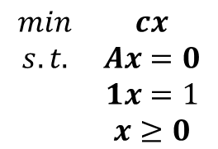
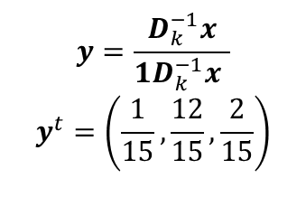

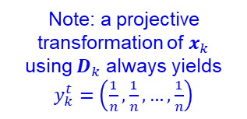
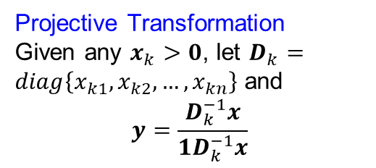

A Few Possible Transformations
$$\begin{matrix}min & cx \\ s.t. & Ax=0 \\ & 1x=1 \\ & x≥0\end{matrix}$$
Affine Transformation
Given any $x_{k}>0$, let $D_{k}=diag\left\{x_{k1},x_{k2},…,x_{kn}\right\}$ and
$$y=D_{k}^{−1}x$$
Projective Transformation
Given any $x_{k}>0$, let $D_{k}=diag\left\{x_{k1},x_{k2},…,x_{kn}\right\}$ and
$$y=\frac{D_{k}^{−1}x}{1D_{k}^{−1}x}$$
For example, if $x_{k}^{t}=\left(\frac{1}{2},\frac{1}{4},\frac{1}{4}\right)$, the point $x=\left(\frac{1}{8},\frac{3}{8},\frac{1}{8}\right)$ is transformed to be…
$$y=D_{k}^{−1}x$$
$$y^{t}=\left(\frac{1}{4},3,\frac{1}{2}\right)$$
$$y=\frac{D_{k}^{−1}x}{1D_{k}^{−1}x }$$
$$y^{t}=\left(\frac{1}{15},\frac{12}{15},\frac{2}{15}\right)$$
$$y≥0$$
Note: a projective transformation of $x_{k}$ using $D_{k}$ always yields $y_{k}^{t}=\left(\frac{1}{n},\frac{1}{n},…,\frac{1}{n}\right)$
$$1y=1$$
$$y≥0$$

Slide 7

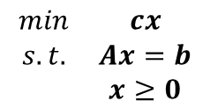
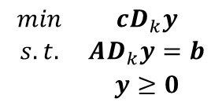

On the Affine Transformation
Identifying the Inverse Transformation
Transforming the Optimization Problem
$$y=D_{k}^{−1}x$$
$$\begin{matrix}min & cx \\ s.t. & Ax=b \\ & x≥0\end{matrix}$$
$$\begin{matrix}min & cD_{k}y \\ s.t. & AD_{k}y=b \\ & y≥0\end{matrix}$$
$$x=D_{k}y$$

Slide 8





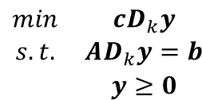




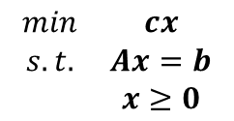








The Problem and the Affinely Transformed Problem
$$\begin{matrix}min & cx \\ s.t. & Ax=b \\ & x≥0\end{matrix}$$
$$\begin{matrix}min & cD_{k}y \\ s.t. & AD_{k}y=b \\ & y≥0\end{matrix}$$
(n=3, m=1 example shown)
$$x_{3}$$
$$y_{3}$$
$$cD_{k}=∇f(y)$$
$$c=∇f(x)$$
$$cD_{k}−c_{p}$$
$$x_{k}$$
$$x_{2}$$
$$AD_{k}y=b$$
$$y_{2}$$
$$y_{k}$$
$$c_{p}$$
$$Ax=b$$
$$y_{k+1}$$
Can we bound this distance?
$$x≥0$$
$$y≥0$$
$$x_{1}$$
$$y_{1}$$

Slide 9

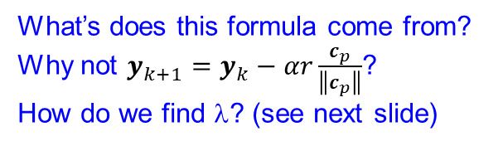




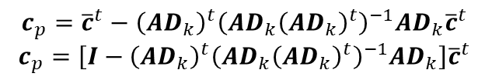


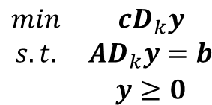

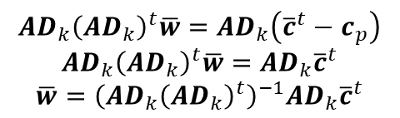








What’s our new iterate? (Finding the best direction)
$$y_{3}$$
$$\begin{matrix}min & cD_{k}y \\ s.t. & AD_{k}y=b \\ & y≥0\end{matrix}$$
$$cD_{k}=∇f(y)$$
$$cD_{k}−c_{p}$$
$$AD_{k}y=b$$
$$y_{2}$$
$$y_{k}$$
$$c_{p}$$
$$y_{k+1}$$
$$y≥0$$
$$y_{1}$$
$$y_{k+1}=y_{k}−λc_{p}$$
What is $cp$?
What’s does this formula come from?
Why not $y_{k+1}=y_{k}−αr\frac{c_{p}}{\left\|c_{p}\right\|}$?
How do we find λ? (see next slide)
${\left(AD_{k}\right)}^{t}\overline{w}={\overline{c}}^{t}−c_{p}$ for some $\overline{w}$
$$c_{p}={\overline{c}}^{t}−{\left(AD_{k}\right)}^{t}\overline{w}$$
$$AD_{k}{\left(AD_{k}\right)}^{t}\overline{w}=AD_{k}\left({\overline{c}}^{t}−c_{p}\right)$$
$$AD_{k}{\left(AD_{k}\right)}^{t}\overline{w}=AD_{k}{\overline{c}}^{t}$$
$$\overline{w}={\left(AD_{k}{\left(AD_{k}\right)}^{t}\right)}^{−1}AD_{k}{\overline{c}}^{t}$$
Why?
What is the next $xk$?
$$x_{k+1}=D_{k}y_{k+1}$$
$$c_{p}={\overline{c}}^{t}−{\left(AD_{k}\right)}^{t}{\left(AD_{k}{\left(AD_{k}\right)}^{t}\right)}^{−1}AD_{k}{\overline{c}}^{t}$$
$$c_{p}=\left[I−{\left(AD_{k}\right)}^{t}{\left(AD_{k}{\left(AD_{k}\right)}^{t}\right)}^{−1}AD_{k}\right]{\overline{c}}^{t}$$

Slide 10
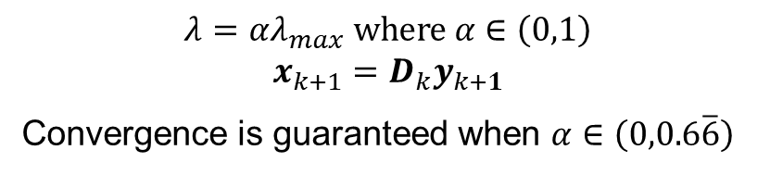
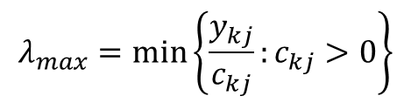



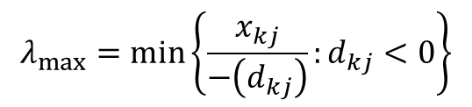
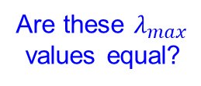
What’s our new iterate? (Finding the step length λ)
$$x_{k+1}=D_{k}y_{k+1}$$
$$y_{k+1}=y_{k}−λc_{p}$$
$$x_{k+1}=x_{k}+λd_{k} where d_{k}=−D_{k}c_{p}$$
$$λ_{max}=min\left\{\frac{y_{kj}}{c_{kj}}:c_{kj}>0\right\}$$
$$λ_{max}=min\left\{\frac{x_{kj}}{−\left(d_{kj}\right)}:d_{kj}<0\right\}$$
Are these $λ_{max}$ values equal?
Why?
$$λ=αλ_{max} where α∈\left(0,1\right)$$
$$x_{k+1}=D_{k}y_{k+1}$$
Convergence is guaranteed when $α∈\left(0,0.6\overline{6}\right)$

Slide 11
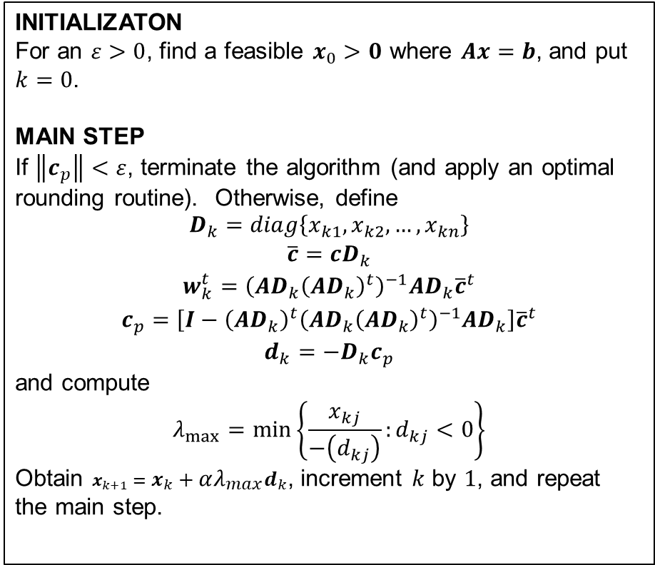
Affine Scaling Algorithm
INITIALIZATON
For an $ε>0$, find a feasible $x_{0}>0$ where $Ax=b$, and put $k=0$.
MAIN STEP
If $\left\|c_{p}\right\|<ε$, terminate the algorithm (and apply an optimal rounding routine). Otherwise, define
$$\begin{matrix}D_{k}=diag\left\{x_{k1},x_{k2},…,x_{kn}\right\} \\ \overline{c}=cD_{k} \\ w_{k}^{t}={\left(AD_{k}{\left(AD_{k}\right)}^{t}\right)}^{−1}AD_{k}{\overline{c}}^{t} \\ c_{p}=\left[I−{\left(AD_{k}\right)}^{t}{\left(AD_{k}{\left(AD_{k}\right)}^{t}\right)}^{−1}AD_{k}\right]{\overline{c}}^{t} \\ d_{k}=−D_{k}c_{p}\end{matrix}$$
and compute
$$λ_{max}=min\left\{\frac{x_{kj}}{−\left(d_{kj}\right)}:d_{kj}<0\right\}$$
Obtain $x_{k+1}=x_{k}+αλ_{max}d_{k}$, increment $k$ by $1$, and repeat the main step.
On what is the termination criterion based?
How would we know if the problem is unbounded?

Slide 12

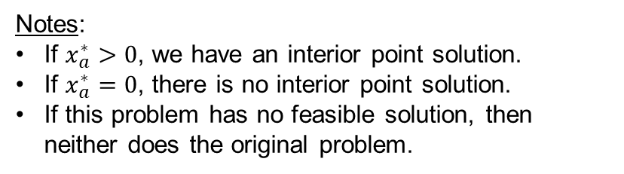
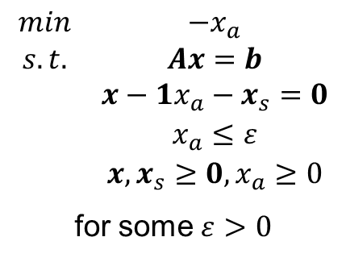


Initialization
How might you find a feasible interior point solution to initialize the problem for the Affine Scaling Method?
What good is this (alternative) formulation?
$$\begin{matrix}max & x_{a} \\ s.t. & Ax=b \\ & x≥1x_{a} \\ & x≥0,x_{a}≥0\end{matrix}$$
$$\begin{matrix}min & −x_{a} \\ s.t. & Ax=b \\ & x−1x_{a}−x_{s}=0 \\ & x,x_{s}≥0,x_{a}≥0\end{matrix}$$
$$\begin{matrix}min & cx \\ s.t. & Ax=b \\ & x≥0\end{matrix}$$
$$\begin{matrix}min & −x_{a} \\ s.t. & Ax=b \\ & x−1x_{a}−x_{s}=0 \\ & x_{a}≤ε \\ & x,x_{s}≥0,x_{a}≥0\end{matrix}$$
for some $ε>0$
Notes:
If $x_{a}^{∗}>0$, we have an interior point solution.
If $x_{a}^{∗}=0$, there is no interior point solution.
If this problem has no feasible solution, then neither does the original problem.

Slide 13
Questions & Discussion

Slide 14
For Next Class
Section 8.6 (pg. 431-434)
Homework #14: Problem 1.25 (Phase 1)
Define sets, parameters, DVs, assumptions!
Note: you will need binary decision variables in addition to non-negative decision variables. See the authors’ hint.
Second, use set-based notation and indexing of DVs and constraints to present a compact formulation

